Slide 1
MetApp
By: Rohit P. Nair, Rohit R. Nair, Sidhart Nambiar, Reyan Kazi
Notes:
Have everyone introduce themselves at the beginning of the presentation and then hand off microphone to the leader. Thank the TYE program, the mentors, and the venue and the audience for their support. Then begin.

Slide 2
Add Anchor Graph Here

Slide 3
Our Value Proposition
Matching with consumers from FaceBook profiles
Undiscovered, High Potential, Passing threshold
Pattern Recognition Algorithms
Notes:
Use a metaphor when explaining the value proposition. “Finding a good app is like a finding a good coffee shop - The big names always come up first and the younger independent ones are hard to find.” We want to fight for the little guys, who build amazing apps with rave reviews, but never get featured at the top of the app stores.”

Slide 4
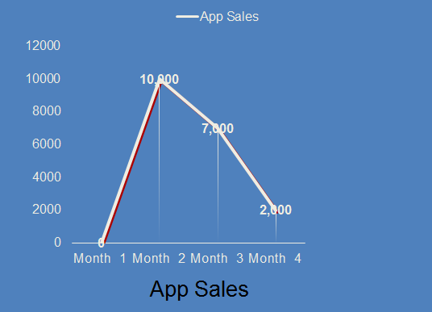
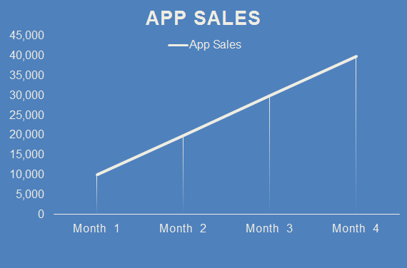
Quantifying our Proposition
Notes:
USE REAL NUMBERS + SHOW UP AND TO THE RIGHT MOVEMENT

Slide 5
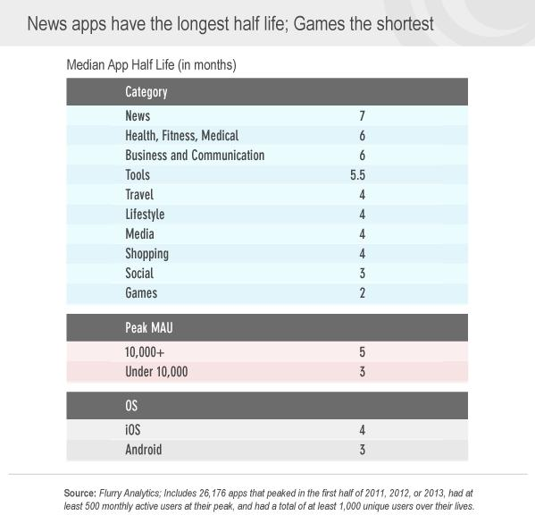
So what is the problem?
700K of the 1.2M apps are dead
Approximate investment of about $500,000 to $2,000,000 per app
Using our analysis approximately 50% of these apps crossed the threshold
Giving us an available market of 350,000 apps
Notes:
700K OF 1.2M APPS ARE DEAD: IN WHAT TIME FRAME, MENTION THAT

Slide 6
We are in the toll business
Warren Buffett says his favorite investments are toll businesses, connecting consumers and producers
Our business is:
Marketing platform for any new, existing, coming up or dying app company which they will pay from their budgets
Charging consumers for subscription
Sponsorship

Slide 7
The Super Heroes
Pack Leader- Rohit P Nair (@rohitnohair)
Bean Counter- Sidhart N. (@SiduNambiar14)
Flyer Passer - Reyan Kazi (@kanyewest)
Computer Boy- Rohit R Nair (@rohitand1)
Old Guy- Chirag G. (@ChicagoGupta)

Slide 8
Values and Vision Mission and Goals
Our vision is to become the global exchange of app companies and consumers
Values include: Simplicity, coordination, and resourcefulness
Goals
Build a network of users
Cater specialized results
Increase downloads for client apps
Collect tolls

Slide 9
LLC STUFF
Limited Liability Company based in the DFW are
Main Office: 1207 Windmere Way Suite #2 Allen, TX 75013
Development Office: 4048 Legacy Trail Suite #3 Carrollton, TX 75010

Slide 10
Why are we better than sliced bread?
There are over 2.5 million apps across Apple App Store and Google Play
New: in a year
Crossing Threshold: in a year
AVAILABLE BUDGETS: COMPANIES, CONSUMER BUYING HABITS ETC

Slide 11
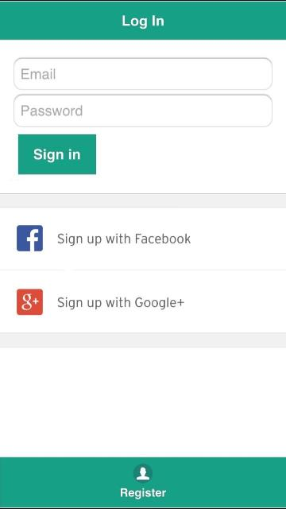
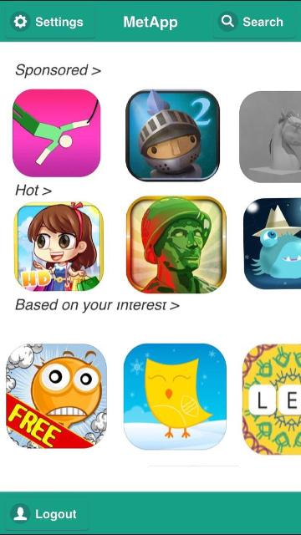
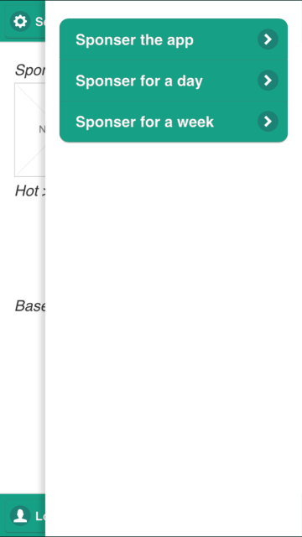
Product Description and Technology
https://popapp.in/projects/55328b201cc4e2264a6cca04/preview

Slide 12
Picture Product
Prototype currently beta stage of testing
UI will mirror an easy to use, Netflix set-up
Organized by sponsored, recommended, featured, etc.

Slide 13
ALGORITHM
In discussions with multiple parties to partner, modify, make it proprietary
TALK A BIT MORE
AVAILABILITY OF SERVER SPEED

Slide 14
Market Analysis and Summary
Size of market: All Facebook users; currently about 1.5 Billion
Companies
New apps:
existing but not stable
dying
Consumers
age and demographics
ad (free) no ad ($1.99)
Sponsors

Slide 15
Market Analysis and Summary
Competition Table, Only consumer focused not working with app companies
NAME | CURRENT SIZE | MAIN DIFFERENCE
BAM | 10,000,000 downloads | No customized mapping, no link to FB, selective app choices
App AllStars | Unavailable last update 2011 | Only shows if App price drops
Appreciate: Android App Market | 500,000 downloads last update 2013 | Android based, no mechanism for threshold crossing apps
BestAppFinder | Unavailable last update 2011 | Recommends trending apps only
Notes:
Target industries are the mobile industry/app industry
Total available market is:Appstore, Google Play Store, and Windows
Proprietary algorithm is at our advantage
Main competition is BestAppFinder (100,000 downloads)
Total audience is 5 million of which we plan to
reach 500,000 users

Slide 16
Marketing Strategy and Implementation
Start with school and university on-ground conversion
Focus on particular school or university activities, link student interests and recommend apps
Use student resources to create low cost sales force
Notes:
Give example of SMU student bodies, going to them and publicizing your app based on specific student interests for that university

Slide 17
Sources of Income
Commission Based (cost per click)
Cost of App ($1.99)
Advertising revenue on free version
Sponsored option on main page

Slide 18
Financial: P&L
Our total capital and reserve cost will be $210,300
MetApp’s total first year revenues amount to $152,238
MetApp’s total first year expenses amount to $160,440
MetApp’s first year Loss is ($8,231)
Our monthly cash break even comes at month 7
See excel sheet

Slide 19
Risk and Exit Strategy
MetApp’s main risk is being able to reach the market.
Solution: Grass roots movement using online communities
Solution: Targeted + data-driven ads (Google AdWords)
People not wanting to spend $1.99
Solution: Use a ‘freemium’ model
Solution: Publicize user testimonials

Slide 20
Risk and Exit Strategy
Exit Strategy:
Sell to large company.
Auction through Flippa
Get buyout through Lease Buyout
Sell to other competition.
Or sell to Google or Facebook.

Slide 21
Summary
200 million users
Achieve 30,000 users
Breakeven in 6 months
App launched
Achieve 100,000 users
July 2015
October 2015
January 2016
July 2016
July 2020

