Slide 1
Illumiloop
TYE Dallas 2015

Slide 2
The Crew
Divya Viswanathan - CEO
Riya Gupta - CMO
Lucas Gates - CTO
Navnit Mohan - CFO
Shameer Soni - Mentor

Slide 3
The Problem
difficulty finding items in bags in the dark
often results in extreme frustration
wasted time searching within the depths of bags
often causes embarrassment
potential safety risk when looking for keys outside home
the time wasted often can be used to do far more productive things

Slide 4
Our Solution
a string of LED lights attaches to the bag
mini clips attach to the lining of the bag and are stuck onto the string of lights
can attach to a multitude of bags
can be moved from bag-to-bag

Slide 5
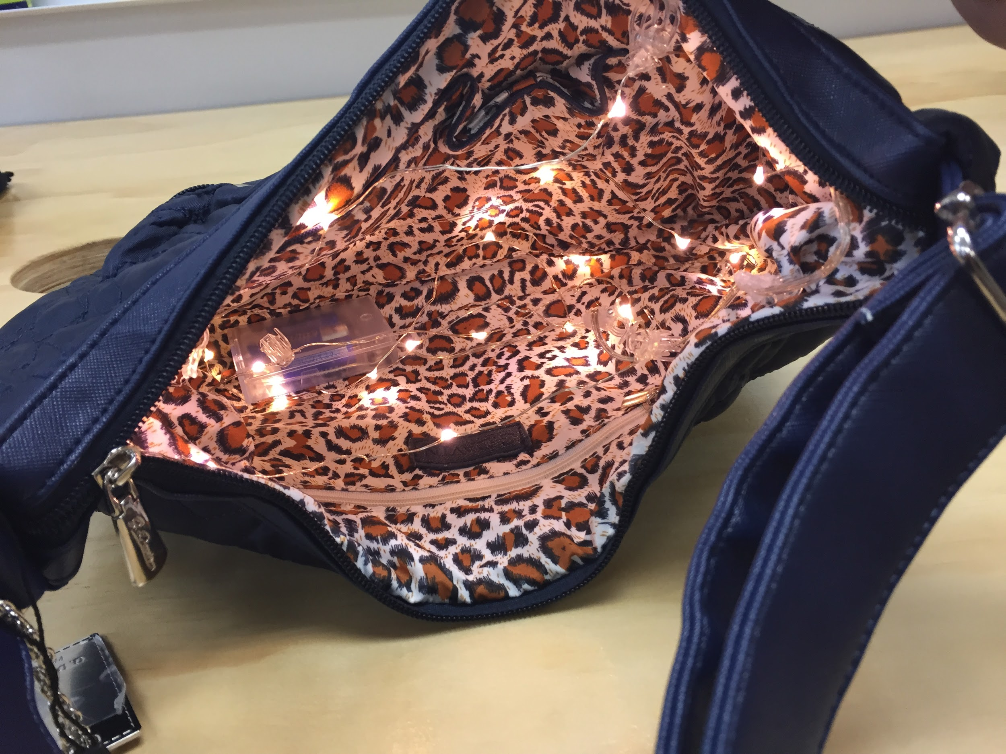
Product Overview
priced at $4.99
a string of LED lights with mini clips integrated into to the string
the clips attach to the bag
a switch near the battery turns it on
uses a button cell battery

Slide 6
Target Audience
primarily for women with purses (age 18+)
high school-college age students with backpacks
males with computer bags, briefcases, etc. (age 25+)

Slide 7
Sales Plan
initial sales through company website during product evolution
branch out into retail soon after, including major retail stores that appeal to our target audience
small mall kiosks/boutiques
Macy’s
JCPenney

Slide 8
Marketing
talk to friends about our solution to the problem they undoubtedly have (and ask them to recommend to other friends)
start pages on social media to popularize our product
start a website to make the product easily-accessible and easily-purchasable
when we break even and have large-scale distribution, we will begin to allocate a portion of our profit to advertising

Slide 9
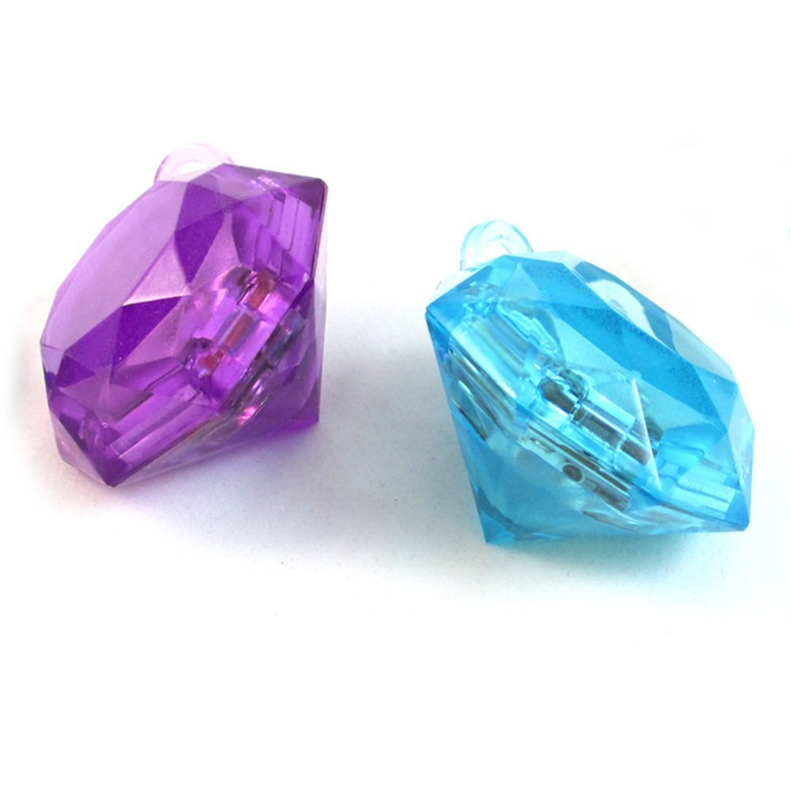
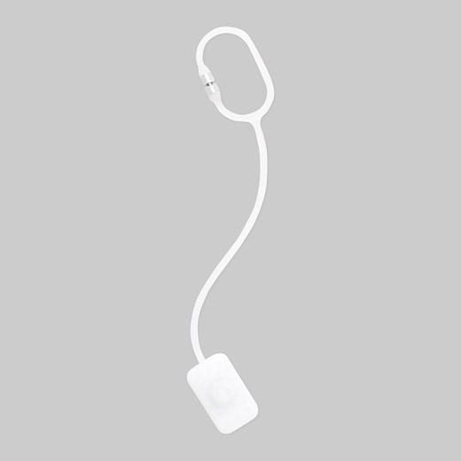
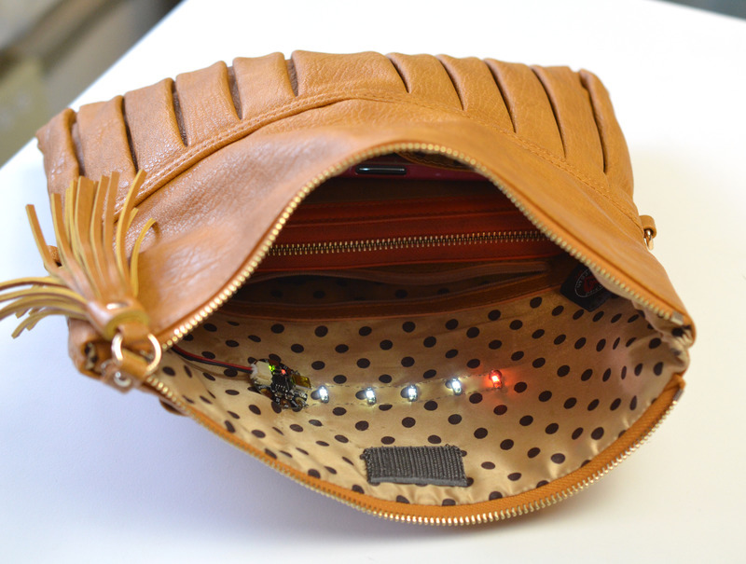
Competition
Glitzsee: $8.50 each
- LED light in container styles as jewel
- shake bag to turn light on for 15 minutes
Adafruit: $27.45
- do it yourself in purse lights
- buy supplies, stitch in yourself
MoMA Light: $10.00
- connect to purse strap
- dangled into bag to illuminate
Problem:
- can be hidden under contents of bag
- shaking of the bag can harm products within
Problem:
- must stitch in yourself
- takes time and effort
Problem:
- dangles off purse strap
- constantly needs to hold power

Slide 10
Production/Manufacturing
Alibaba will provide us with the parts and will ship them to the US where we will manufacture product
we will outsource our production to China manufacturer
storage and delivery will primarily take place in our individual garages for the first quarter of sales
Similar operational plan

Slide 11
Fulfillment
originally customers will order our product through our website where we will receive the order details and ship the necessary product from our own garages
as our business grows rapidly we hope to run fulfillment through an alternate fulfillment service company
Amazon Fulfillment Services

Slide 12
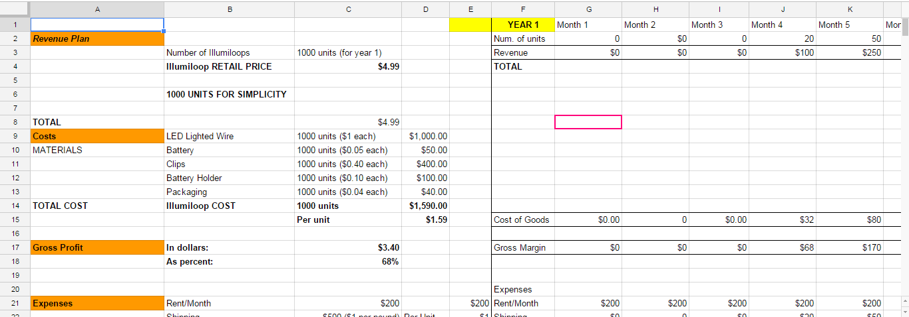
Financials
Link to Financials

Slide 13
Unit Economics

Slide 14
Financial Detail

Slide 15
Summary and Next Steps
Month 1-3
-begin ordering shipments
Month 4
-begin online sales
-execute marketing
Month 10
-break even
Month 10+
-sell and make profit
Month 15
-sell at small boutiques and mall kiosks
Month 24
-sell at big retail shops
-more products
requesting $2,800 in funding from investors

